Slide 1
Finance Function & Business Performance
Team Structure
Business Achievements
Reports Timing

Slide 2

My Team Structure 2026 {18 Members}
Hussein Abo Elazaim
FP&A Senior Business Partner
Mohamed Abd Allah
Ahmed Mazhar
Mohamed Tawab
Emad Awad
Financial Analysis
Dept Manager (under promotion)
Revenue&AR Accounts Manager (Commercial)
Revenue&AR Accounts Manager (B2B&B.Partner)
Revenue&AR Accounts Manager (Deelz)
Mohammed Tolba
Abdelkader Mohamed
Mahmoud M. Ibrahim
Ahmed Dahab
Revenue Accounts Section Head
Revenue Accounts Section Head
Revenue S. Accountant
B2B & B. Partner Financial Analyst Lead
Ahmed Gamal (left the team)
Motaz Bayomi
Mahmoud Farid
Sayed Kadry
AR Accounts Section Head
S. Accountant –B2B
AR S. Accountant
Deelz Financial Analyst Lead
Ahmed Gaber
Mohamed Emad Bayomi
Amr Ashraf
S. Accountant
S. Accountant –B2B
Commercial Fin. Analyst Lead
Ahmed Samer
Hany Sameeh
TBD
S. Accountant
S. Accountant –B Partner
Tech Care & A.S. Fin. Analyst
Mohamed Hassan
S. Accountant –B Partner

Slide 3
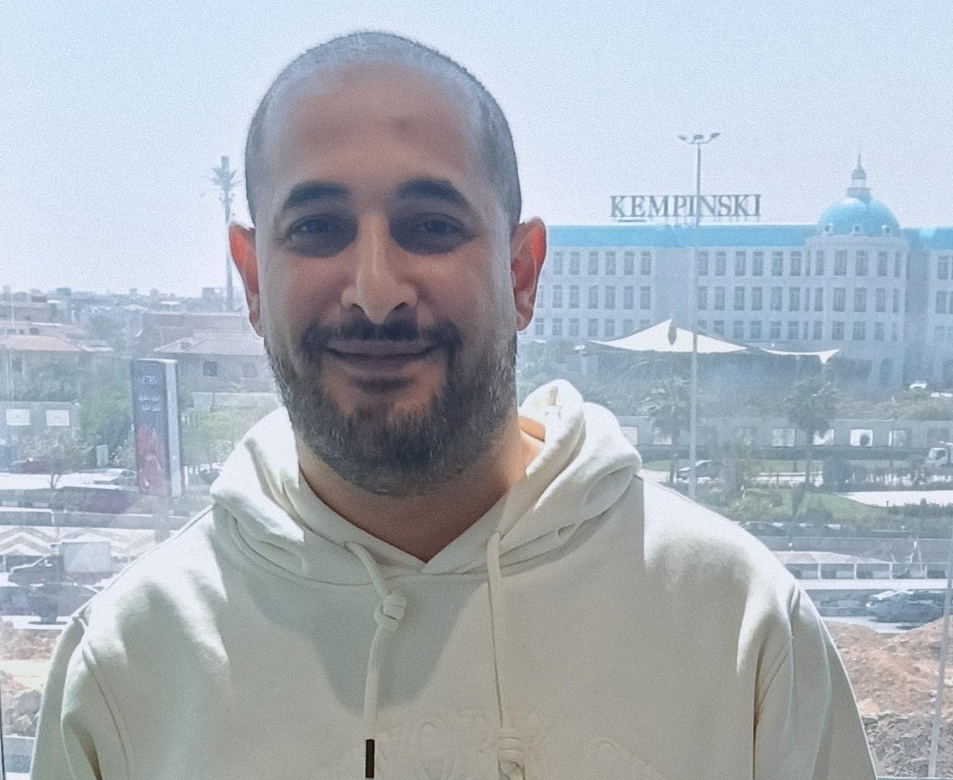
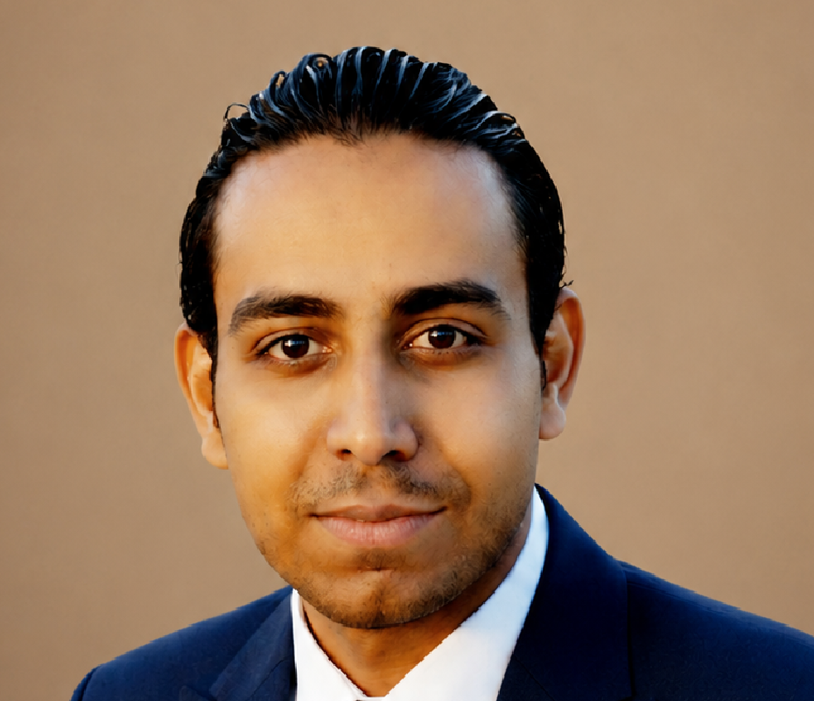
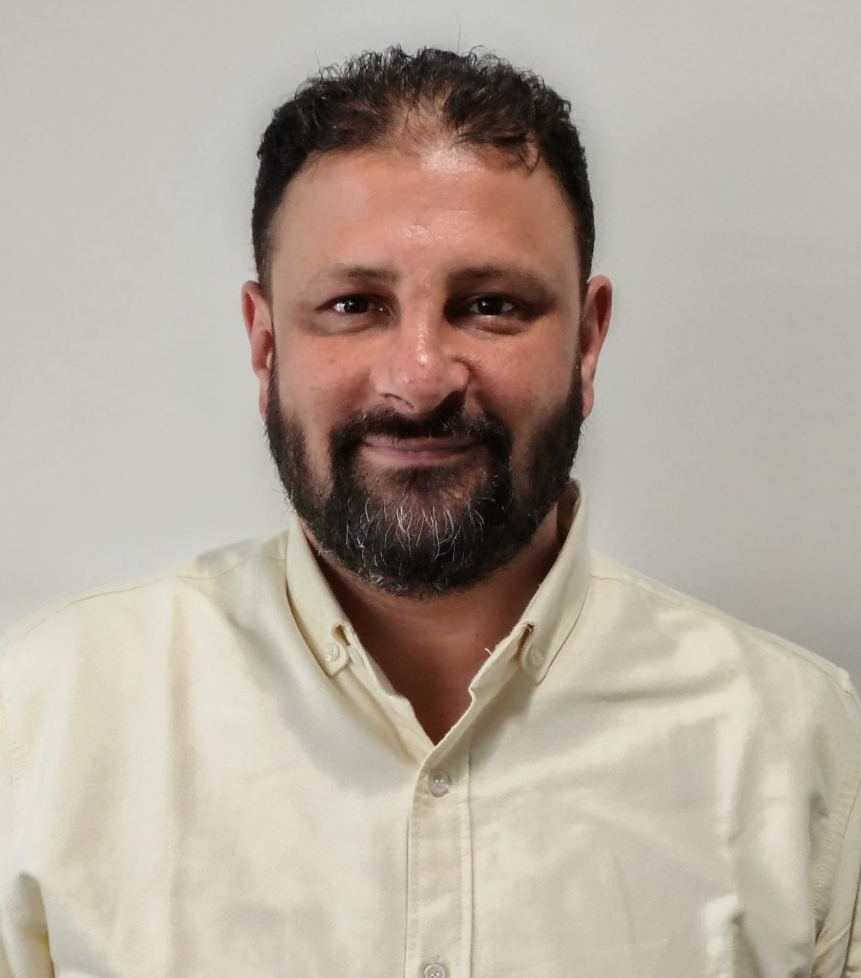
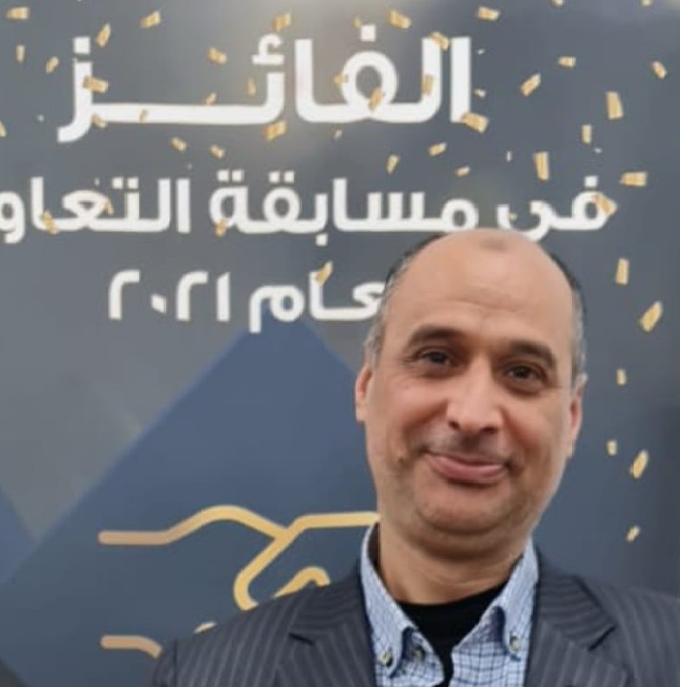
Financial Planning & Analysis Sector
Hussein Abo Elazaim
Career Path
OKRs 2026
1999–2004 | Accountant (banks-GL-Purchase)
2005-2005 | Sales Accounts Section Head
2006–2009 | Treasury Dept Manager
2010–2012 | Budgeting & Reporting Dept Manager
2013–2021 | Commercial Agencies Accounts Dept Manager
2022–2023 | FP&A Business Partner (Commercial-Deelz
2023–2024 | FP&A Business Partner (Commercial-Deelz-B2B)
2024–Present | FP&A Sr. Business Partner (B2B Channels and A.S. Service)
Support partners(Commercial - Deelz - B2B - B.Partner - Tech care - Service ) Achieving target topline and Gross profit.
Support partners (Commercial - Deelz - B2B - B.Partner - Tech care - Service )Achieving target bottom line
Support partners (Commercial - Deelz - B2B - B.Partner - Tech care - Service ) to enhance their Cash Flow by achieving targeted collections
Retain Top Performers: 100%
Accounts & Fin. Analysis Department (Commercial - Deelz - B2B –B.Partner- Services -Tech care )
FP & A Senior Business Partner
Mohamed Abdullah
Mohamed Tawab
Ahmed Mazher
Emad Awad
Financial Analysis Dept Manager (under promotion
B2B-B.partner AR & Revenue Manager
Commercial A.R & Revenue Accounts Manager
Deelz A.R & Revenue Accounts Manager
Career Path
Career Path
Career Path
Career Path
2005–2006 | Branch Accountant
2007–2013 | Sr. AR Accountant - Sr. Reporting & Budget Acct.
2014–2016 | Inventory & AP Section Head
2017–2023 | Inventory & AP Manager (Service)
2024–2025 | AR & Revenue Manager – Deelz
2026–Present | Financial Analysis
Dept Manager (under promotion)
2010–2013 | Branch Accountant
2014–2017 | Sr. AR Accountant
2018–2022 | AR&Revenue Section Head
2023–Present | Accounts Manager for B2B and B_Partner Sectors
2005–2010 | Branch Accountant - | AP Accountant
2011–2016 |Senior AP & Commercial Inventory Accountant
2017–2023 | Inventory Manager
2024–2025 |Commercial, Deelz and B2B Financial Analyst Sr. Lead
2026–Present | Commercial A.R & Revenue Accounts Manager
1999-2010 | Accountant (Retail Customers – Audit- Branch Follow-up)
2011–2016 | AR&Revenue Section Head
2017–2025 | AR & Revenue Manager – Commercial
2026–Present | AR & Revenue Manager – Deelz
Key initiatives
Power BI Dashboards
Transforming all reports from Excel to dynamic dashboards
Coupon Redemption System
Automated coupon redemption tracking system
Electronic Archive
All commercial invoices & receipts from 2020 to today
AX Microsoft Dynamics Implementation Finance process transformation support
OKRs 2026
OKRs 2026
OKRs 2026
OKRs 2026
Support partners(Commercial - Deelz - B2B - B.Partner - Tech care - Service ) Achieving target topline and Gross profit.
Support partners (Commercial - Deelz - B2B - B.Partner - Tech care - Service )Achieving target bottom line
Retain Top Performers: 100%
Support partners to Growing topline and achieving B2B (1.1 Bn) - B_partner (1.1 Bn)
Support partners B2B & B_partner to enhance their Cash Flow by achieving targeted collections
Retain Top Performers: 100%
Support partners to Growing topline and achieving Commercial (1,09Bn)
Support partners Commercial to enhance their Cash Flow by achieving targeted collections
Retain Top Performers: 100%
Support partner "Deelz" to Growing topline to reach 1.4bn
Support partner "Deelz" to Deliver Gross Profit Margins of 87.5mn (6.3%)
Retain Top Performers: 100%

Slide 4
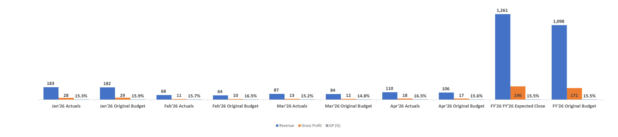
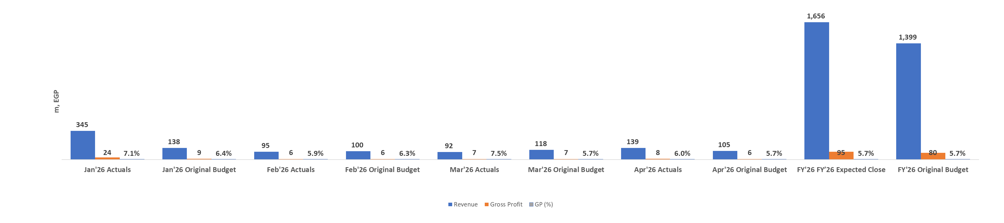
Trade Performance Insights
Insights: Actuals achieved 103% of sales budget and 102% of GP budget mainly driven by Ariston and Indesit sales
Commercial Sales Distribution
Head of Channel: Ahmed Abdel Monsef
Deelz
Insights: Actuals achieved 146% of sales budget and 162% of GP budget mainly driven by MDA and TV inside stores in Jan.
Head of Channel: Ismail Sabry
FY’26 Latest Estimate vs. Original Budget’26

Slide 5
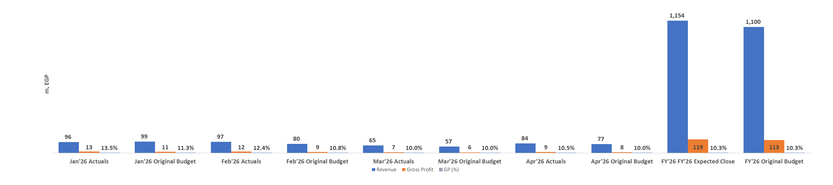
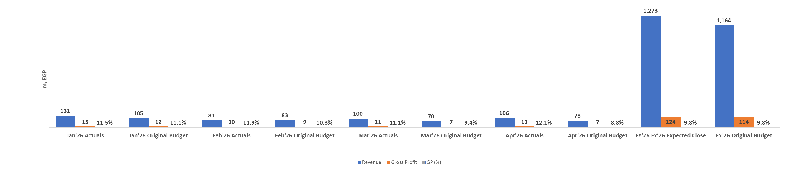
Trade Performance Insights
Insights: Actuals achieved 109% of the sales budget, and 121% of the GP budget driven by TV sales and B2B Items
B.TECH Business
Head of Channel: Mohamed Abdelhamid
B.Partner
Insights: Actuals achieved 124% of the sales budget, and 145% of the GP budget driven by MDA, TV and Mobile sales
Head of Channel: Wael Enani
FY’26 Latest Estimate vs. Original Budget’26

Slide 6
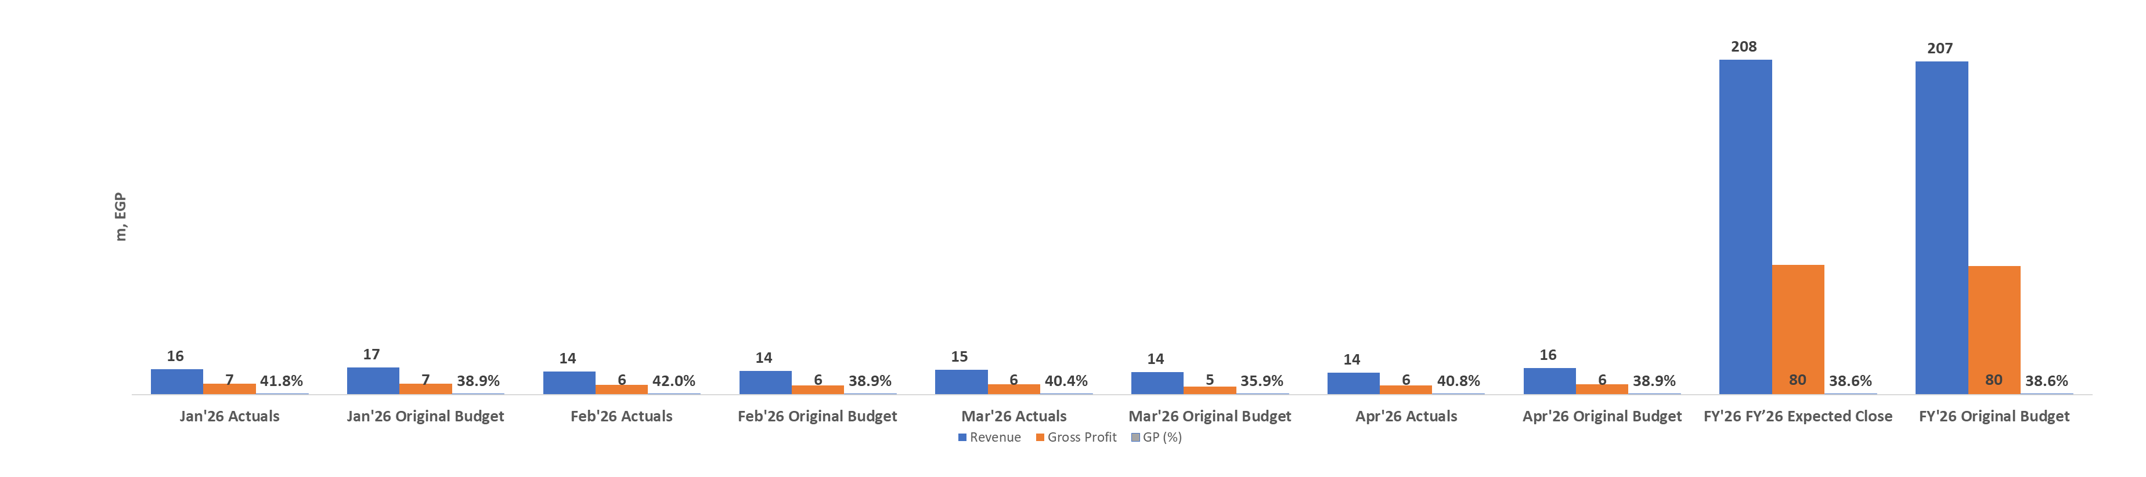
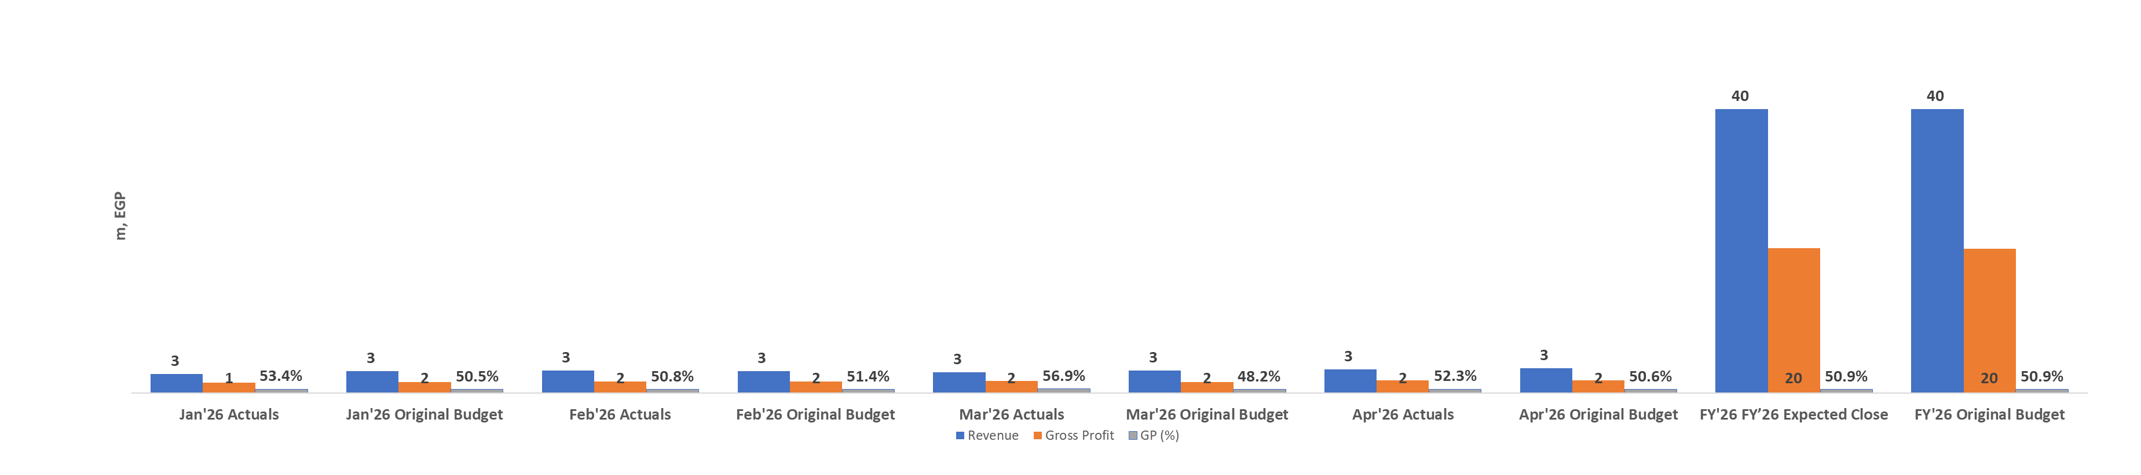
Trade Performance Insights
Insights: Actuals achieved 97% of sales budget and 102% of GP budget driven by favorable mix.
TECH CARE
Head of Channel: Omar Said
After Sales Service
Insights: Actuals achieved 95% of sales budget and 100% of GP budget driven by favorable mix.
Head of Channel: Khaled Aboelhamd
FY’26 Latest Estimate vs. Original Budget’26

Slide 7
FINANCIAL REPORTING MATRIX
REPORT NAME
FREQUENCY
RECIPIENT
TYPE
Commercial sales Performance Report
Daily + Monthly
Department & Sector Heads
POWER BI
P&L Commercial
Monthly
Sector Head
POWER BI
EXCEL
Weekly
Sector Head & Department Managers
Commercial Collections Report
POWER BI
2 Time weekly
Collection department manger + Sales managers
Commercial Aging update
EXCEL
2 Time weekly
Salespersons
Commercial Customer statement report
EXCEL
Monthly
Department managers
POWER BI
Commercial Sales Vs Return
Monthly
Tax department
Commercial sales tax
EXCEL
Commercial Sales
Monthly
Cost Department
EXCEL
Monthly
Hr. Department - Payroll
Commercial Monthly Brands Sales Report
EXCEL

Slide 8
FINANCIAL REPORTING MATRIX
REPORT NAME
FREQUENCY
RECIPIENT
TYPE
Weekly
Cost Department
EXCEL
Providing AR Data to working Capital report
Other Channels Agencies sales
Daily
Commercial director
EXCEL
EXCEL
Daily + Monthly
Department & Sector Heads
B2B Sales Performance Report
POWER BI
P&L B2B
Monthly
Sector Head
POWER BI
EXCEL
B2B Collections Report
Weekly
Sector Head & Department Managers
POWER BI
Daily + Monthly
Department & Sector Heads
POWER BI
B.Partner Sales Performance Report
Monthly
Sector Head
P&L B.Partner
POWER BI
B.Partner Collections Report
Weekly
Sector Head & Department Managers
POWER BI
EXCEL
Quarterly
Finance Department Manager
Statement of Financial Position Analysis
EXCEL

Slide 9
FINANCIAL REPORTING MATRIX
REPORT NAME
FREQUENCY
RECIPIENT
TYPE
Daily + Monthly
Department & Sector Heads
Service Sales Performance Report
POWER BI
P&L Service
Monthly
Sector Head
EXCEL
POWER BI
EXCEL
Daily + Monthly
Department & Sector Heads
Deelz Sales Performance Report
POWER BI
P&L Deelz
Monthly
Sector Head
POWER BI
EXCEL
Deelz Collections Report
Weekly
Sector Head & Department Managers
POWER BI
Monthly
Tax department
EXCEL
Deelz slaes Tax repot
2 Time weekly
Cost Department
Deelz CL sales
EXCEL
Daily
Category manager & Sector Heads
Commercial Inventory Analysis Report
POWER BI
EXCEL
Daily
Category manager & Sector Heads
EXCEL
Deelz Inventory Analysis Report
POWER BI

Slide 10
FINANCIAL REPORTING MATRIX
REPORT NAME
FREQUENCY
RECIPIENT
TYPE
Daily
Category manager & Sector Heads
Open Purchase Orders Report – Deelz & Commercial
EXCEL
Weekly
Category manager & Sector Heads
EXCEL
Commercial DOH Report
POWER BI
Weekly
Category manager & Sector Heads
Deelz DOH Report
POWER BI
Deelz Inventory Ratio
Monthly
Category manager & Sector Heads
POWER BI
Deelz Non-Listed Items Report
Monthly
Category manager & Sector Heads
POWER BI
Monthly
Category manager & Sector Heads
Commercial Non-Listed Items Report
POWER BI

